Slide 1
The Travellers Game
By The Traveller

Slide 2
The Game Goals
The goal of this game to beat all the Traveller Genie trials to be granted your freedom
As you progress through the game you will be give option that will dictate how your travel and what may happen
Why has the Traveller Genie has appeared before it simple he loves games, and he has chosen you as you love to travel, and he will try to stop you

Slide 3
Why is called the Travellers Game
People love travelling you get you see new place, meet new people and of course its fun like a game
When planning a trip there will always be variability to initial plan certain delays maybe the weather but there will be an element of surprise to them making them more memorable
And for a similar reason we chose a genie as they are a mystery and can grant you the wildest of adventures in a lifetime

Slide 4
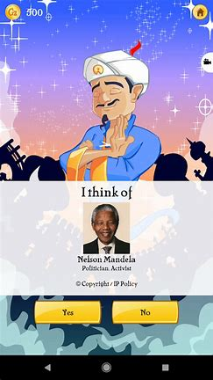
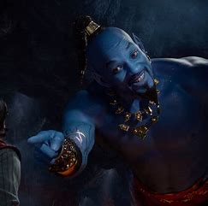
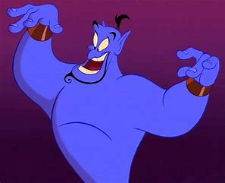
Famous Genies

Slide 5
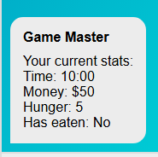
Game Mechanics
Hunger drains as you progress
Show your current time
Cash to buy food

Slide 6
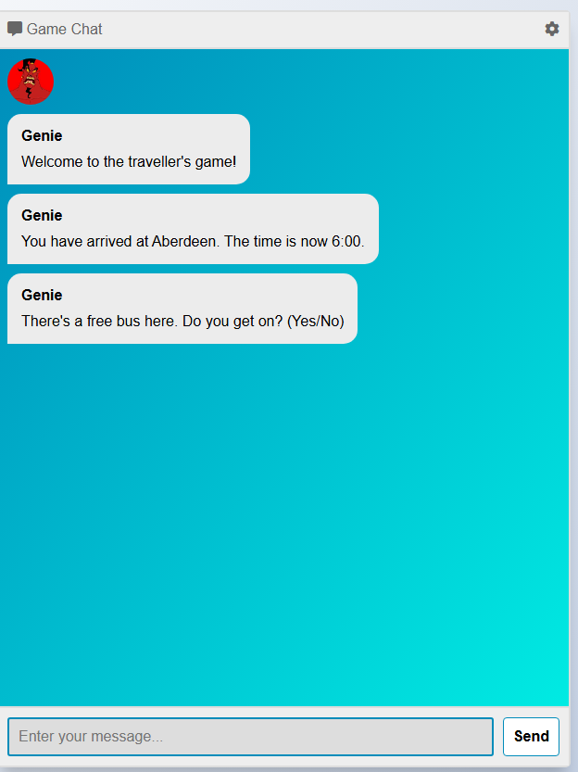
User Interface
This how the user interface looks like making it seem like you're chatting with him but it’s a web browser

Slide 7
Live Demo

